Slide 1
Plant Nutrient Uptake
A presentation by: Shimul Bapari
Instructor: Md. Mahbub-E-Noor
Computer Science and Engineering
University of Barishal
Course: Computer Fundamental and Office Application
Date: 08-10-2024

Slide 2
Plant Nutrient Uptake Data
Plant Name | Soil pH | Soil moisture | N uptake(mg) | P uptake(mg) | k uptake(mg) | Micronutrient uptake | Growth rate | Yield | Total nutrient uptake | Average nutrient uptake | Deficiency
Wheat | 6.3 | 45 | 32 | 14 | 30 | 7 | 1.5 | 300 | 83 | 20.75 | 3.614458
Corn | 6.6 | 43 | 28 | 11 | 35 | 5 | 1.3 | 250 | 79 | 19.75 | 3.164557
Tomato | 6.5 | 46 | 34 | 18 | 32 | 11 | 1.7 | 240 | 95 | 23.75 | 2.526316
Rice | 6.2 | 42 | 27 | 17 | 37 | 3 | 1.4 | 280 | 84 | 21 | 3.333333
Maize | 6 | 47 | 35 | 22 | 39 | 6 | 1.5 | 350 | 102 | 25.5 | 3.431373
Ground nut | 6.3 | 41 | 28 | 21 | 42 | 9 | 1.8 | 330 | 100 | 25 | 3.3
Barley | 6.9 | 44 | 36 | 16 | 37 | 7 | 1.2 | 280 | 96 | 24 | 2.916667
Sugarcane | 6.8 | 47 | 38 | 21 | 45 | 4 | 1.5 | 250 | 108 | 27 | 2.314815
Mustard | 6.6 | 49 | 37 | 19 | 36 | 8 | 1.3 | 300 | 100 | 25 | 3
This table presents a comparison of nutrient uptake, growth rate, and yield across various crops. It highlights essential macronutrient (N, P, K) and micronutrient absorption, offering insights into soil health and potential nutrient deficiencies for optimizing crop performance.

Slide 3
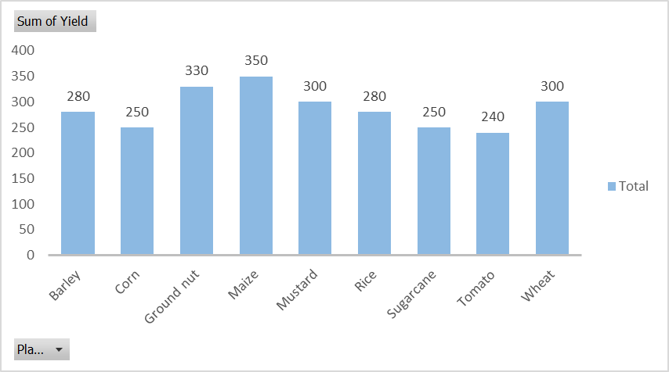
This bar chart show the yield of various crops, including Barley, Corn,
Groundnut, Maize, and others. Maize has the highest yield at 350g, followed by Groundnut and Mustard.
The chart provides a visual comparison of crop performance, useful for evaluating productivity and making informed agricultural decisions.

Slide 4
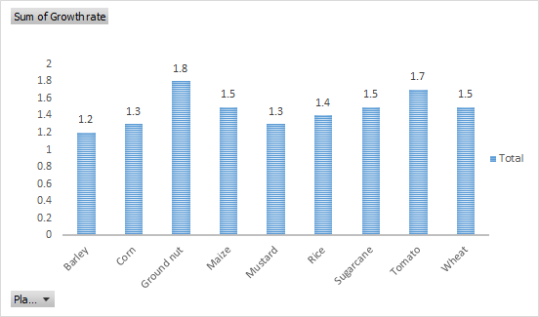
This chart displays the growth rates of various crops, with Groundnut achieving the highest rate at 1.8, followed by Tomato at 1.7.
Barley has the lowest growth rate at 1.2. These growth rate differences reflect how effectively each crop converts nutrients into biomass, providing insights for optimizing growth conditions and crop selection.

Slide 5
This chart showcases the total nutrient uptake of different crops. Sugarcane leads with the highest nutrient uptake at 108, followed by Maize at 102, while Corn has the lowest at 79.
These values reflect the crops' nutrient absorption efficiency, offering insights for improving fertilization strategies and boosting crop productivity.

Slide 6
This chart highlights the micronutrient uptake of various crops. Tomato shows the highest uptake at 11, followed closely by Groundnut and Mustard. Rice has the lowest micronutrient uptake.
These differences underline the varied micronutrient needs of each crop, providing essential information for precise nutrient management to maximize crop health and yield.

